Slide 1
Navigating Existing VAT Functionality
Key Features Clients Must Know and Planning for Future Enhancements – Presented by Vidoosh B Sing
Notes:
Good Morning All and thank you Henry for the introduction. Once again welcome to session 35. Navigating Existing VAT Functionality: Key Features Clients must know and planning for future enhancements. I know it is a mouth full.

Slide 2
Navigating Existing VAT Functionality
Key Features Clients Must Know and Planning for Future Enhancements – Presented by Vidoosh B Sing

Slide 3
Table of contents
Topic

Slide 4
Topic

Slide 5
ITS Integrator
No VAT
Not VAT Registered
VAT Registered
Notes:
The ITS Integrator system caters for countries where No VAT or GST is allowed, for countries where VAT or GST is allowed but the Institution is not registered but pays over the input VAT or GST, or for countries where VAT or GST is allowed, and the Institution is registered to claim output VAT.

Slide 6
FCSM-1 SODs
Notes:
If VAT needs to be applied, then SOD 01 for subsystem CS should be set to Y.

Slide 7
FCSM-1 Subsystems
Notes:
You can also set VAT per system. In this example you can see the Student Debtors system is set to exempted while accounts receivable or sundry debtors is set to Standard Rated. This is because in South Africa Educational Services rendered by an accredited educational institution is exempted from VAT however in the example this Institution is registered for VAT and can claim output VAT hence sundry debtors would be standard rated.

Slide 8
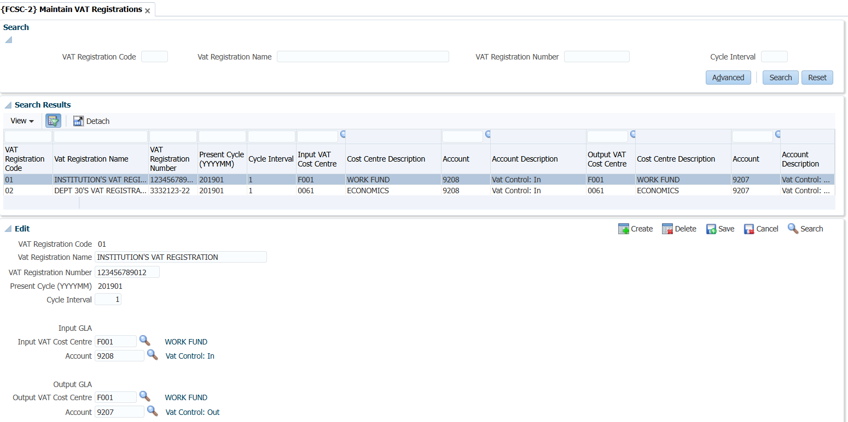
FCSC-2 VAT Registration
Notes:
Seeing as in my example the Institution is registered, this information is captured and maintained in FCSC option 2. You can have multiple VAT registrations linked to different ledgers. Extremely important is the Input and Output Cost Centre and Account details.

Slide 9
FCSC-1 VAT Rates
Notes:
VAT Rates need to be set, and these would normally be Exempted, Zero Rated, Standard Rated or Apportioned. Apportioned being the % the revenue authority allows you to claim on mixed services. Currently capped at 12,5% of 15% but you can apply to SARS for a higher rate with evidence and/or motivation.

Slide 10
FCSO – 1 Cost Centres
Notes:
Vat rates and Ledgers are linked on the cost centre. It is extremely important the type of services that will be rendered and costs incurred on the cost centre are determined prior to the cost centre being created.
There may be a need to use VAT consultants to determine the Vat rate to link to the cost centre especially research grants from countries with double taxation agreements.
As indicated the standard vat rates would be Exempted especially for teaching and learning costs centres.
Zero Rated where applicable.
Standard rated where these fully vatable services or expenses.
And apportioned where there mixed services e.g. Finance, HR, IT, Security, and this case Library services.

Slide 11
FCSO -1 Page 2
Notes:
Note the Ledger, VAT Registration and VAT code linked. In this case apportioned which is 10% of the 15%. So in this case if the expense was fully vatable at 15% and the value was 100 excluding VAT you could claim R1,50 back from your output VAT.
Also note from the VAT Registration Code the Input and Output GLA.

Slide 12
FCSO – 3 Accounts
Notes:
A few years ago, we introduced an indicator on the account definition to allow clients to indicate if input VAT is denied on that account only. In order to prepare for this session, I checked 4 clients account definitions and there were no accounts where input VAT is denied.

Slide 13
Input VAT Denied
Goods or services acquired by a vendor for purposes of entertainment;
Fees or subscriptions payable for membership of any sporting, social or recreational club, association, or society;
Any motor car supplied to or imported by the vendor; or
Any goods or services acquired by a medical scheme or sickness, accident or unemployment fund for the purposes of supply by the fund of any medical or dental services.
Source: https://www.auditpartners.co.za/a/4423/vat--when-can-input-vat-not-be-claimed (2008)
Notes:
This is a list of items where input is denied from Audit Partners dated 2008. So, while it maybe outdated you can see that the first two items would be applicable in an Education Institution.

Slide 14
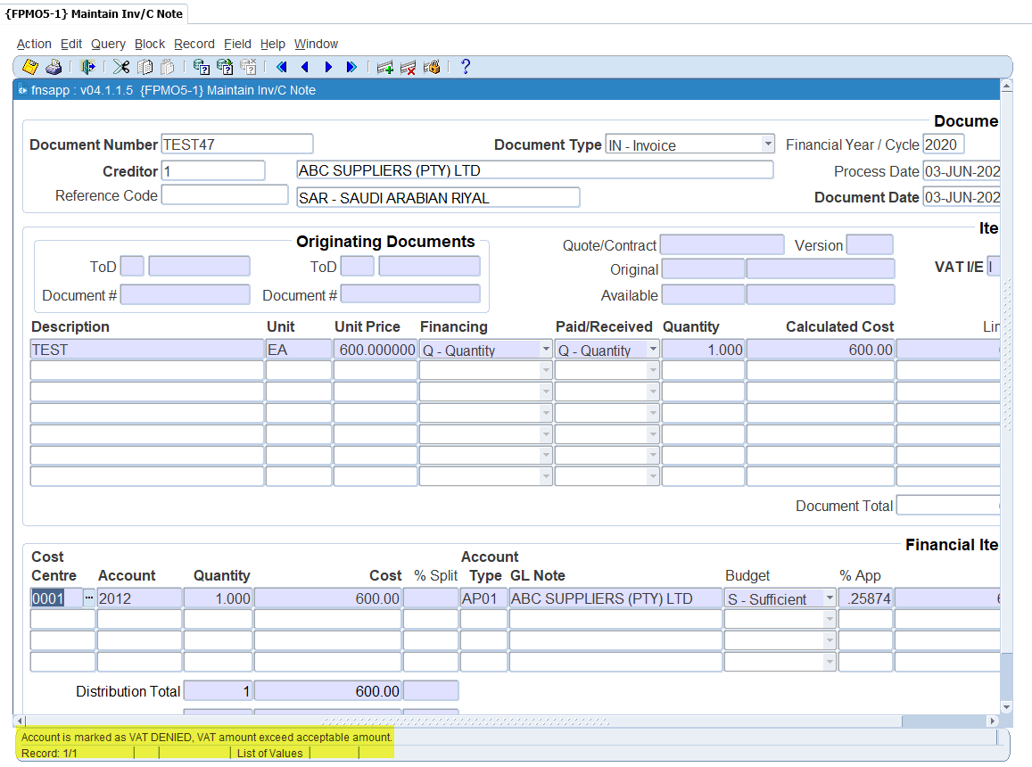
FPMO5 – 1 VAT Denied
Notes:
If the indicator was set and the data capturer tried to process a transaction with VAT the user will receive a validation message which will not allow them to save the transactions. Here is an example of the validation on an invoice.

Slide 15
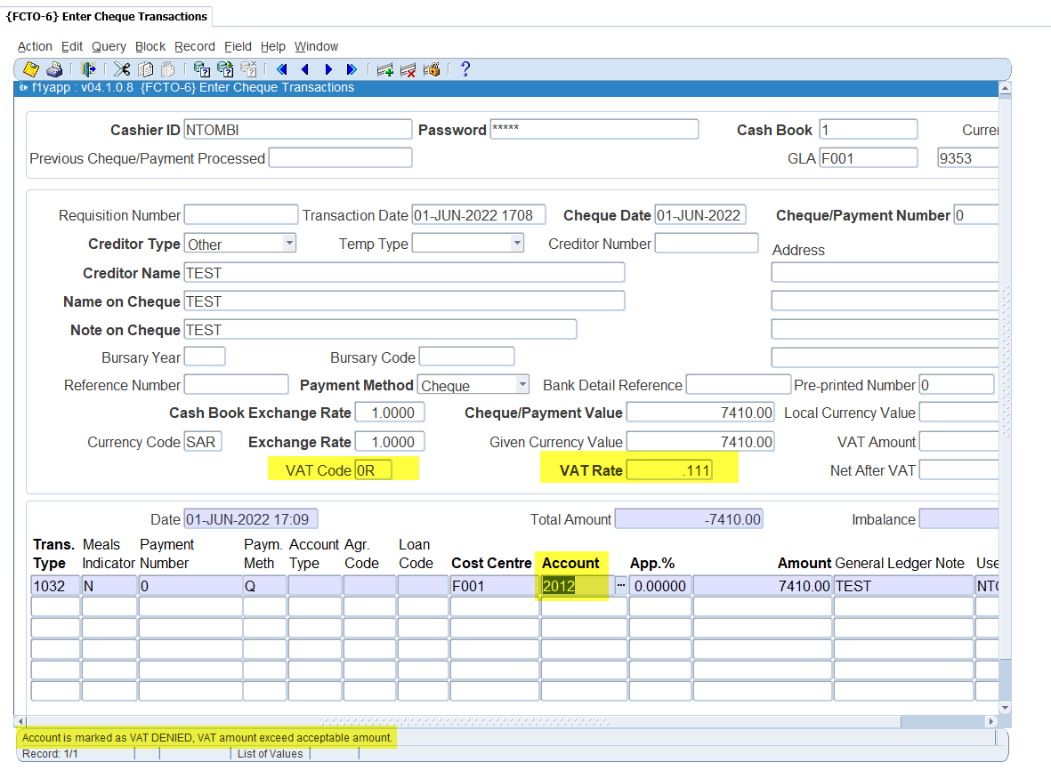
FCTO – 6 VAT Denied
Notes:
And this is an example of the validation on a payment transaction.

Slide 16
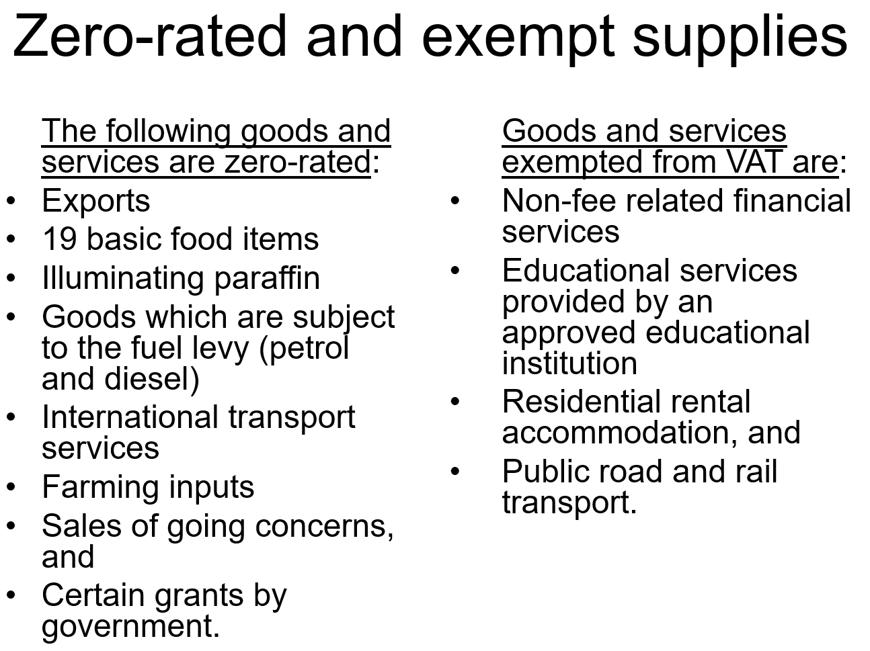
Exempted and Zero-Rated Items
Source: https://www.treasury.gov.za/comm_media/presentations/Zero-rated%20and%20exempt%20supplies.pps (Unknown)
Notes:
This list was drawn from a PowerPoint presentation on the treasury website, so I am not sure how up to date this is. You will note the exempted services highlighted hence my earlier comment on the SD system being Exempted.
We have clients who also supply exempted services and zero-rated supplies and foodstuff.
So you should also have accounts which do not allow VAT on these.

Slide 17
FCTO - 3 Zero VAT
Notes:
Currently the validation is working on the VAT Denied indicator hence the validation message but we will be changing this as a bug.

Slide 18
FARO – 1 Zero VAT
Notes:
This is on Sundry Debtor invoices.

Slide 19
FCSM – 1 Supplier Registered
Notes:
Recently and when I say recently more like a year ago we introduced a validation on if the supplier is VAT Registered. The SOD B2 for subsystem PM must be set to N.

Slide 20
FPMM – 2 VAT Registered No
Notes:
If the VAT Reg is also set to N on the supplier definition.

Slide 21
FPMO1 – 1 VAT Not allowed
Notes:
And the data capturer processes a transaction for the supplier with VAT it will not allow the user to save the transaction. We have noted request to change the validation outcome to make the VAT zero and allow the user to save the transaction.

Slide 22
Other SODs
Notes:
There are also some SODs that can assist the Institution to default VAT information.
AV defaults the VAT Code and TX defaults if the transaction will include or exclude VAT.

Slide 23
Notes:
If you are successful with all of the above and process your transaction correctly you should get a VAT Refund.

Slide 24
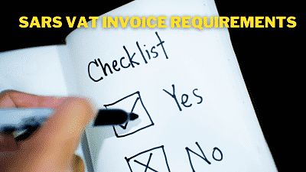
Future Enhancements
VAT 201 Return
Reversing or adding VAT
Reallocating transactions
Meeting with Infinite Tax
SIG

Slide 25
Tomorrow????

Slide 26
Tomorrow????

